Slide 1
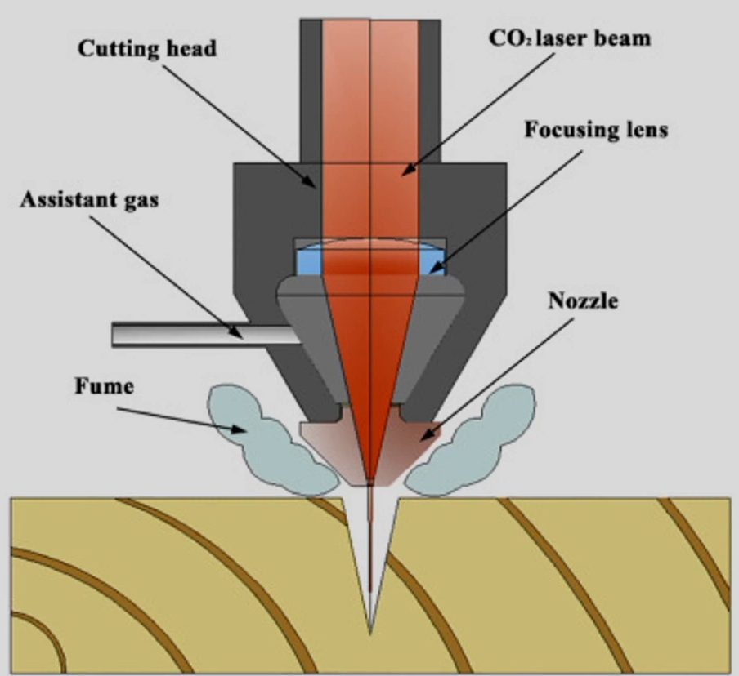
Laser cutting
Laser cutting
Pyrolytic
Photolytic
Pyrolytic
Material removal is due to heating of the substrate material.
Melting and evaporation.
Pulsed laser producing light in the infrared or visible part of the spectrum (Nd:YAG and CO2) are used.

Slide 2
The power density in the laser spot should be the order of 106 W/cm2 or higher.
Material melts and some of it evaporates at the bottom of the hole created.
Rapid expansion of the vapour > a steep pressure gradient arises with the surrounding atmosphere > causes the molten material and vapour to be rapidly ejected from the hole (‘molten ejection’).
Generate recast layer on the inside wall of the hole.
Sometimes builds up the dross at the entrance or exit of the hole.
At higher power densities (over 108 W/cm2) material removal by evaporation is controlled > less cast build up and better hole quality.

Slide 3
Photolytic process
Material removal from the breaking of chemical bonds.
To break molecular bonds, the energy level of each single photon must be higher than the bond energy, of the order of few electron volts.
Excimer lasers emit light of very short wavelength (i.e. in the UV spectrum)
The photon energy is then in the range of 4 to 8 eV, powerful enough to break many of the molecular bonds of natural and synthesized materials.

Slide 4
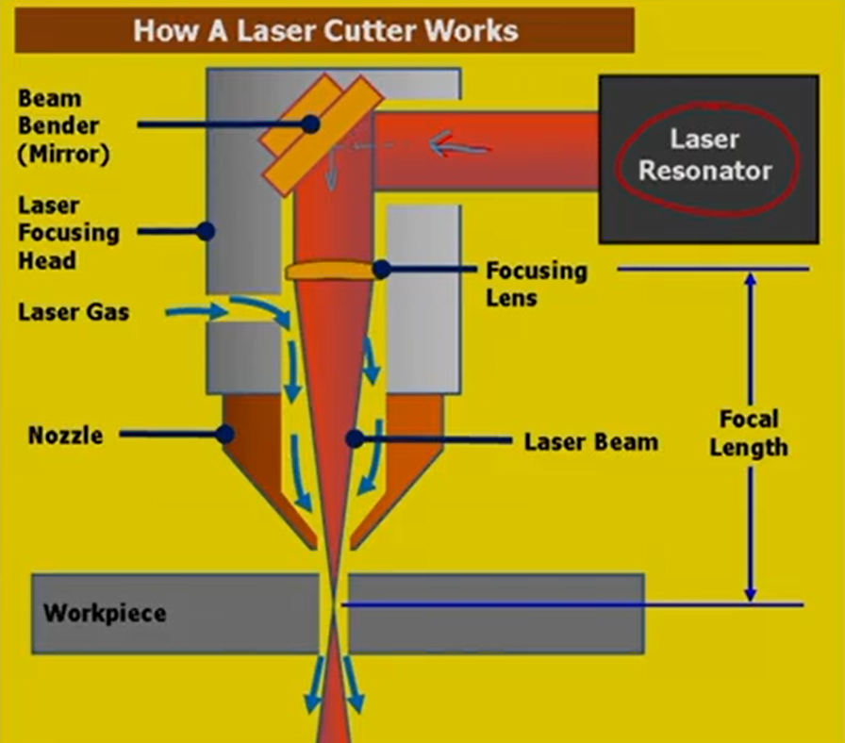
Arrangements of laser cutting
Laser cutting-
Thermal process
Focused laser beam is used to melt material in localized area.
A co-axial gas jet is used to eject the molten metal and create a kerf.
A continues cut is generated by stirring the laser beam on workpiece under CNC control.
There are three major categories of laser cutting
Fusion cutting
Flame cutting
Remote cutting

Slide 5
Fusion cutting
An inert gas (typically nitrogen) is used to expel the molten material out of kerf.
Nitrogen gas does not exothermically react with the molten material > does not contribute to the energy input.
Flame cutting
Oxygen is used as the assistant gas.
Exerts mechanical forces on the molten material + creates an exothermic reaction > increases the energy input to the process.
Remote cutting
The material is partially evaporated (ablated) by a high intensity laser beam allowing thin sheets to be cut with no assist gas.

Slide 6
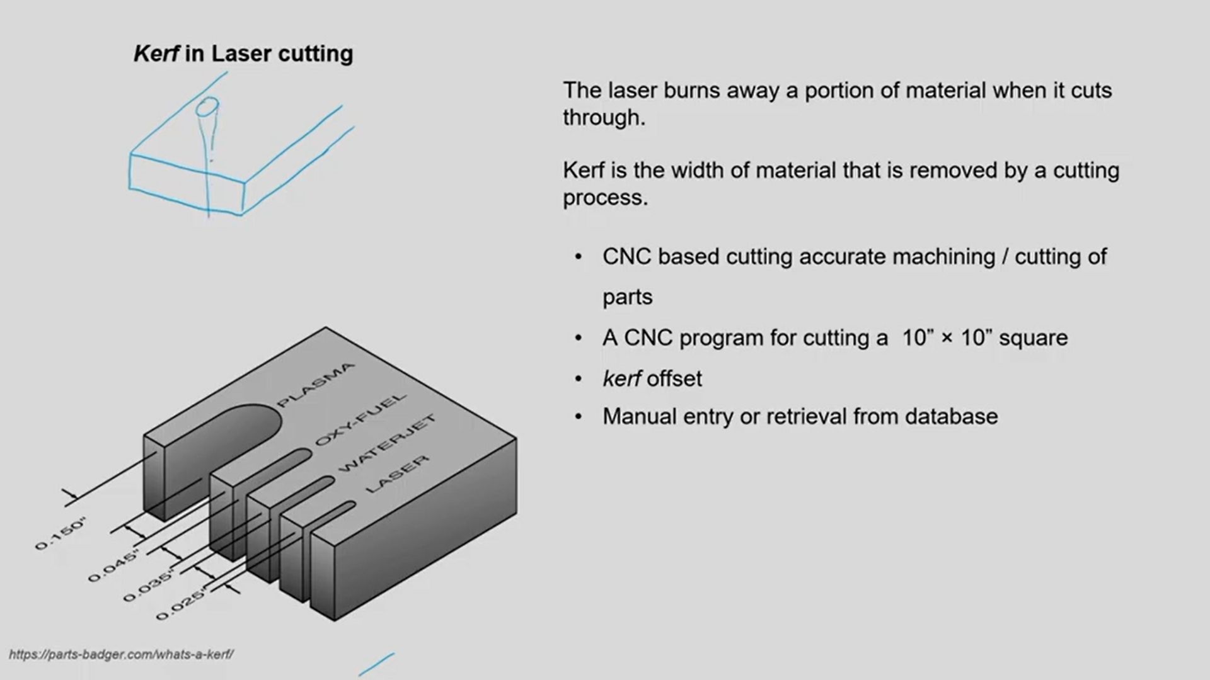
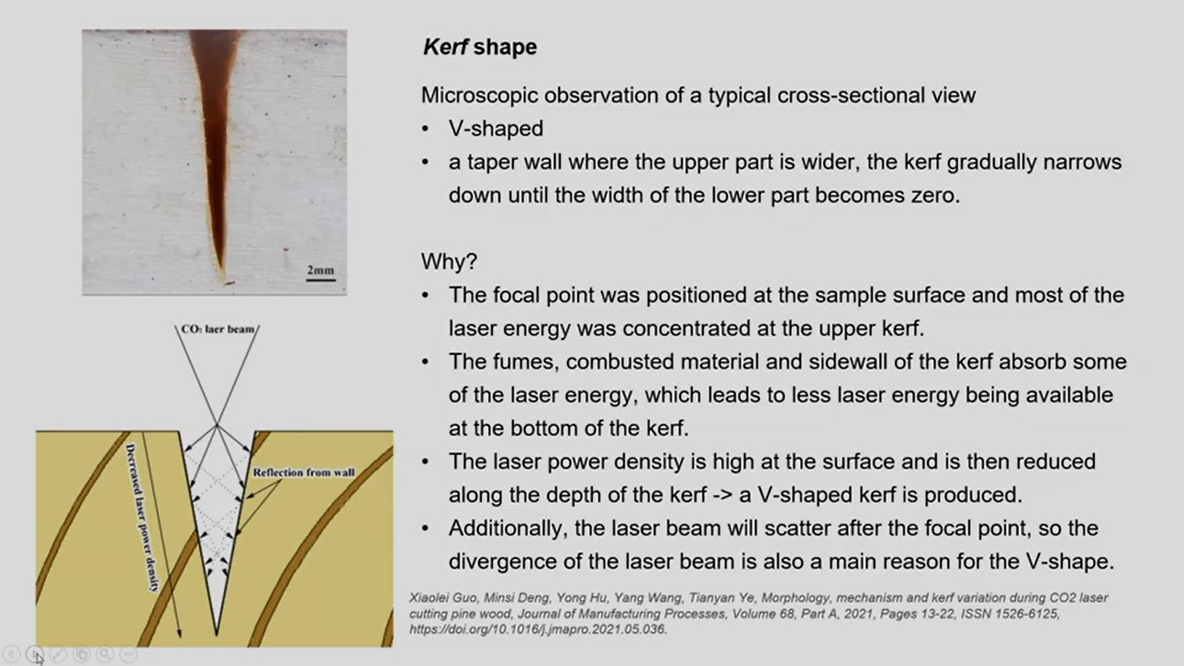
Kerf in laser cutting
The laser burns away a portion of material when it cuts through.
Kerf is width of material that is removed by a cutting process.
Kerf shape
V-shaped
A taper wall where the upper part is wider, the kerf gradually narrows down until the width of the lower part becomes zero.

Slide 7
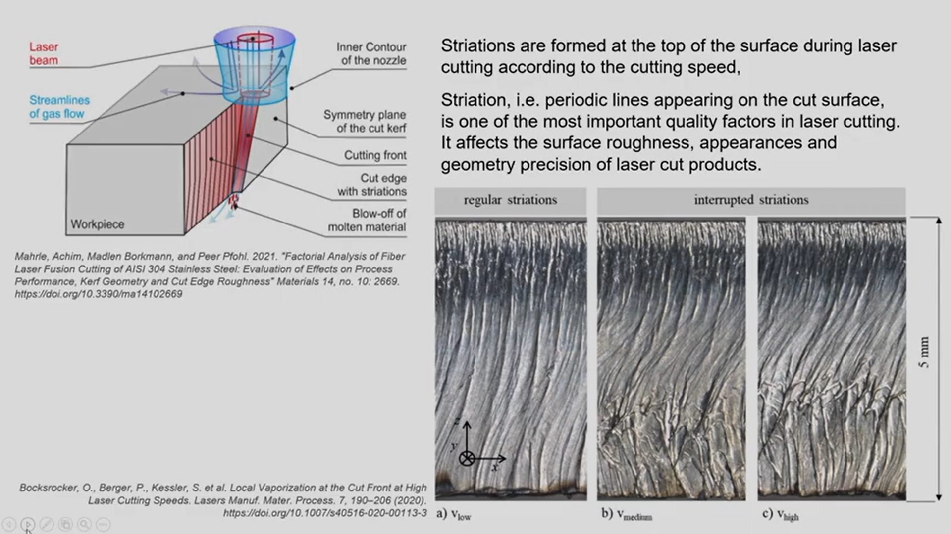
Striations are formed at the top of the surface during laser cutting according to cutting speed.
Striation, i.e. periodic lines appearing on the cut surface, is one of the most important quality factors in laser cutting.
It affects the surface roughness, appearance and geometry precision of laser cut products.

Slide 8
Metal Joining Process

Slide 9
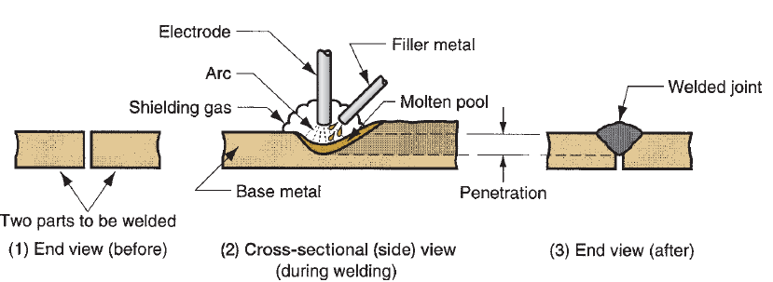
Joining
The term joining is generally used for welding, brazing, soldering, and adhesive bonding, which form a permanent joint between the parts—a joint that cannot easily be separated.
Welding is a materials joining process in which two or more parts are coalesced at their contacting surfaces by a suitable application of heat and/or pressure.
Many welding processes are accomplished by heat alone, with no pressure applied; others by a combination of heat and pressure; and still others by pressure alone, with no external heat supplied.
In some welding processes a filler material is added to facilitate coalescence.

Slide 10
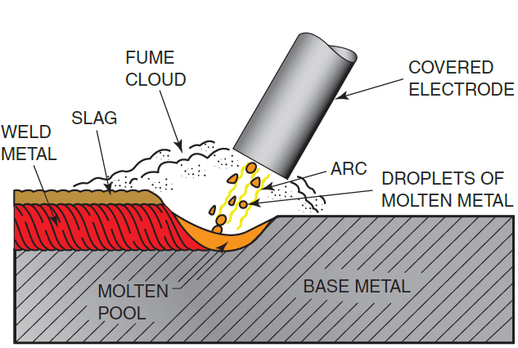
Arc welding
Shielded metal arc welding (SMAW) is a welding process that uses a flux-covered metal electrode to carry an electrical current.
The current forms an arc across the gap between the end of the electrode and the work.
The electric arc creates sufficient heat to melt both the electrode and the work.
Molten metal from the electrode travels across the arc to the molten pool on the base metal, where they mix together.
As the arc moves away, the mixture of molten electrode and base metal solidifies and becomes one piece.

Slide 11
Joint designs
In addition to the standard butt, lap, tee, and outside corner joints, at some time SMAW has been certified to be used to weld every possible joint design.
Metal types
Although mild steel is the most commonly welded metal, a wide variety of electrode types allow SMA to be used to weld and hard face almost any metal or alloy, including cast iron, aluminum, stainless steel, and nickel.
Metal thickness
Metal as thin as 16 gauge, approximately 1/16 in. (2 mm) thick up to several feet thick, can be SMA welded.
All positions
The flat welding position is the easiest and most productive because large welds can be made fast using SMA welding, but the process can be used to make welds in any position.

Slide 12
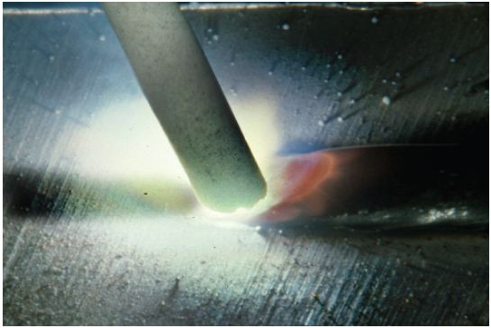
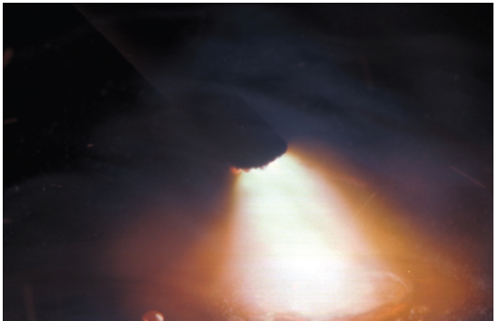
Arc Length
The arc length is the distance the arc must jump from the end of the electrode to the plate or weld pool surface.
As the weld progresses, the electrode becomes shorter as it is consumed.
To maintain a constant arc length, the electrode must be lowered continuously.
Shorter arc lengths: Shorter arc lengths may cause the metal transferring across the gap to short out the electrode, causing it to stick to the plate.
Long arc lengths: Long arc lengths produce more spatter because the metal being transferred may drop outside of the molten weld pool.

Slide 13
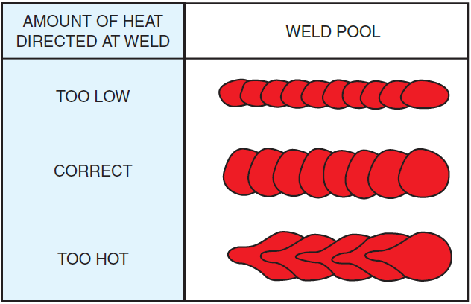
SMA Welding Arc Temperature
An arc’s temperature is dependent on the voltage, arc length, and the atmosphere (gas or vapor) it is passing through.
The arc temperature can range from approximately 5500°F (3000°C) to more than 36,000°F (20,000°C), but most SMA welding arcs have effective temperatures of approximately 11,000°F (6100°C).
The voltage and arc length are closely related because as the arc length increases, the arc resistance increases; therefore, it takes a higher voltage (pressure) to keep the electrons flowing (jumping) across the gap.
The shorter the arc, the lower the arc’s resistance and the lower the arc’s voltage and the lower the temperature produced;
as the arc lengthens, the resistance increases, thus causing an increase in the arc voltage and temperature.
SMA Welding Arc Heat
The amount of heat produced by the arc is determined by the amperage.
The higher the amperage setting, the higher the heat produced by the welding arc; the lower the amperage setting, the lower the heat produced.
Each electrode diameter has a recommended minimum and maximum amperage range and, therefore, a recommended heat range.

Slide 14
P1. Two 1mm thick steel sheets are to be spot welded at a current of 5000A. Assuming effective resistance to be 200 micro-ohms and current flow time of 0.2 second, find out the heat generated during the process.
P2. In an arc welding process, the voltage and current are 25V and 300A respectively. The arc heat transfer efficiency is 0.85 and welding speed is 8 mm.(s)⁻¹. Find out the net heat input in J/mm.
P3. Two pipes inner dia = 100 mm and outer dia = 110 mm, flash butt welding V = 30V at the interface 1 mm of material melts from each pipes which has R = 42.2 ohms, unit of melt energy = 64.4 MJ/m^3, the time require for welding (s) = ?

Slide 15
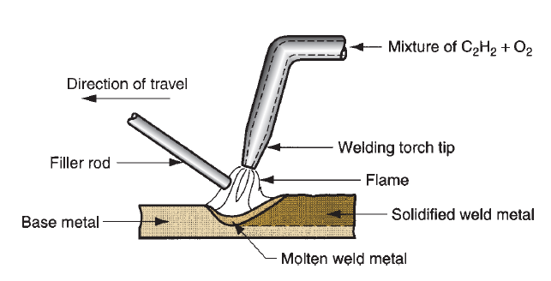
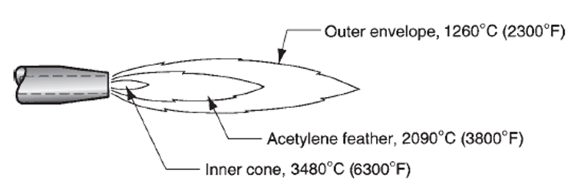
Gas Welding
Welding is performed by a flame formed by the combustion of oxygen and acetylene. The flame comes from a torch.
A filler rod coated with flux is used sometimes which prevents oxidation, creating a better joint.
Acetylene is a famous fuel because it is capable of generating a temperature of 3500°C.
The chemical reaction between oxygen and acetylene happens at two stages as given below.
C₂H₂ + O₂ → 2CO + H₂+ Heat (First stage; inner core)
The products of first reaction are combustible and second reaction occurs as,
2CO + H₂ + 1.5O₂ → 2CO₂ + H₂O + Heat (second stage; outer envelope)

Slide 16
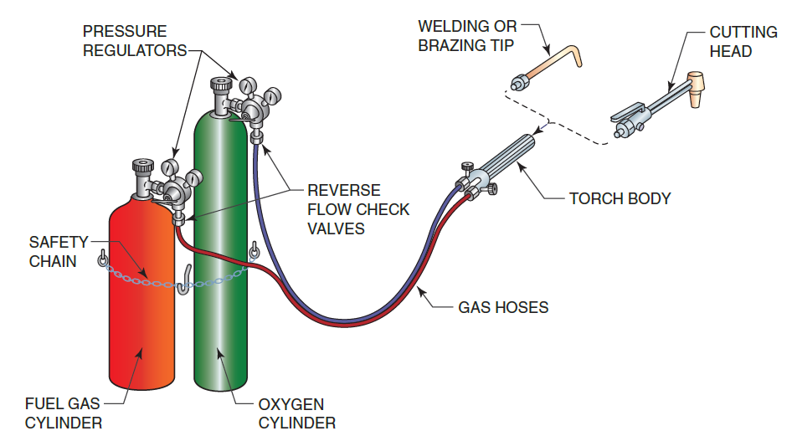
Gas Welding
When both oxygen and acetylene are mixed in ratio of 1:1, then neutral flame is seen as shown in figure.
The outer envelope delivers a temperature of 1260°C and inner core has app. 3500°C.
The first stage reaction is seen in the inner cone of the flame (bright white colour), while the second stage reaction is seen in the outer envelope (colorless but with tinges ranging from blue to orange). The temperature is very high at the inner core which is app. 3500°C.
Total heat liberated during the two stages of combustion is 55×10⁶ J/m^3 of acetylene.

Slide 17
Factors Affecting the Weld
Torch Tip Size
The torch tip size should be used to control the weld bead width, penetration, and speed.
Torch Angle
The torch angle and the angle between the inner cone and the metal have a great effect on the speed of melting and size of the molten weld pool.
Welding Rod Size
Welding rod size and torch manipulation can be used to control the weld bead characteristics.

Slide 18
Problems and advantages of OAW
The combination of acetylene and oxygen is highly flammable and hence hazardous to environment.
It is unstable at pressures much above 1 atm.
It is mandatory for the welder to wear gloves, goggles etc. as preventive measures.
The equipment is relatively cheap and portable. So it is used as an economical, versatile process that is well suited for low quantity production and repair jobs.
It is rarely used to weld plates thicker than 6.5 mm.

Slide 19
Brazing and Soldering
Brazing and soldering are both classified by the American Welding Society as liquid-solid phase bonding processes.
The phase is the temperature at which bonding takes place between the solid base material and the liquid filler metal.
The only difference between brazing and soldering is the temperature at which each process takes place.
It is possible to do both brazing and soldering using different mixtures of the same base metal, depending on the alloys used and their melting temperatures.
you can silver braze and silver solder depending on the alloy.

Slide 20
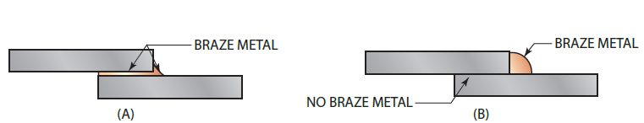
Brazing
Brazing occurs at a temperature above 840°F (450°C), and the parts being joined must be fitted so that the joint spacing is very small, approximately 0.025 in. (0.6 mm) to 0.002 in. (0.06 mm).
This small spacing allows capillary action to draw the filler metal into the joint when the parts reach the proper phase temperature.
Braze Welding
Braze welding can be done with the same brazing alloys as brazing, so the only difference is it does not need capillary action to pull filler metal into the joint.

Slide 21
Soldering
Soldering takes place at temperatures below 840°F (450°C).
The soldering process may or may not use capillary action to pull the solder into the joint.
When capillary action does occur, just like brazing, the joint strength increases several times greater than the solder itself.

Slide 22
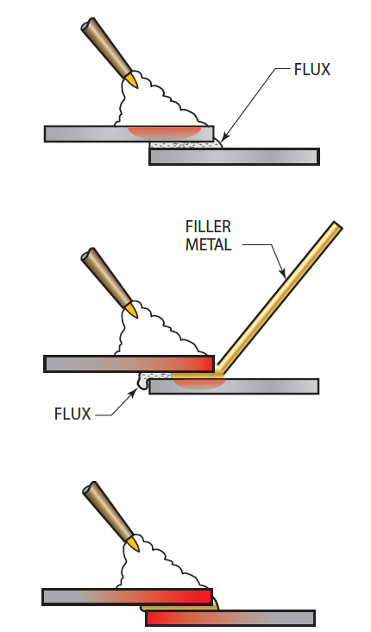
Flux
Fluxes used in brazing and soldering have three major functions:
They must remove any oxides that form as a result of heating the parts.
They must promote wetting, which is the phenomenon whereby a liquid filler metal or flux spreads and adheres in a thin, continuous layer on a solid base metal. In soldering the process is often called tinning.
They should aid in capillary action by pulling the molten alloy into the joint.

Slide 23
Advantages Of Brazing and Soldering
Low temperature
Because the base metal does not have to melt, a low-temperature heat source can be used.
May be permanently or temporarily joined
Because the base metal is not damaged, parts may be disassembled at a later time by simply reapplying heat. The parts then can be reused.
However, the joint is solid enough to be permanent.
Dissimilar materials can be joined
It is easy to join dissimilar metals, such as copper to steel, aluminum to brass, and cast iron to stainless steel.
It is also possible to join nonmetals to each other or nonmetals to metals.
Ceramics are easily brazed to each other or to metals.
Speed of joining
Parts can be preassembled and dipped or furnace soldered or brazed in large quantities,
A lower temperature means less time in heating.

